Slide 1
Paleography
Reading seventeenth-Century Handwriting

Slide 2
The huamn mnid deos not raed ervey lteter by istlef, but the wrod as a wlohe. The oredr of the ltteers in the wrod can be in a total mses but you can sitll raed it wouthit any porbelm. (http://www.nationalarchives.gov.uk/palaeography/where_to_start.htm)

Slide 3
Challenges
Spelling is not standardized
Cursive alphabet
Challenging handwriting
Abbreviations
Different language/names for items
Specialized Quaker terms

Slide 4
Tips for reading
Think of reading as a code to break
Read one letter at a time.
Help yourself by looking for other examples of same letter elsewhere in the document.
If you are stuck, move on and come back later.
Context is important – look for clues.
Think about vocabulary. Check out the Transcription Manual and Glossary.

Slide 5
Practice Reading for Fun

Slide 6
Transcription Template
[Transcriber’s Name]
15911 – Roger Longworth Peter Hendricks August 31 1686 Transcription
Dublin ye [the] 21 of ye [the] 6mo 1686
Deare Piter [Peter] Hendricks,
my verie Deare and well beloved freind in the Lord Jesus Christ in
whom we have Rest and peace for ever more, who is the Rocke and
foundation of all our freesh [fresh] springs, and hath begotten us by his owne
everlasting power, near and Deare [one?] unto another, and in this Love
and Life is my saluttacion [salutation] unto thee, and all deare freinds in those
parts of the world, god all mighty be with you all Bless and prosper
you for ever more saith my soule, and now Deare Piter [Peter] I Received thine dated the 18 of the 6 mo: [month] which I was verie glad of, and ever
shall be, to heare of your well being, and allso of Thomas green

Slide 7
Resources
Paleography at the British National Archives http://www.nationalarchives.gov.uk/palaeography/
Video – Introduction to Transcribing https://www.youtube.com/watch?v=x_Sh4M5tLfs&feature=youtu.be
Letter-writing in Renaissance England https://folgerpedia.folger.edu/Letterwriting_in_Renaissance_England#Exhibition_materials
Features of layout in 16th and 17th Scottish Letters http://www.helsinki.fi/varieng/series/volumes/14/meurman-solin_b/#csc

Slide 8
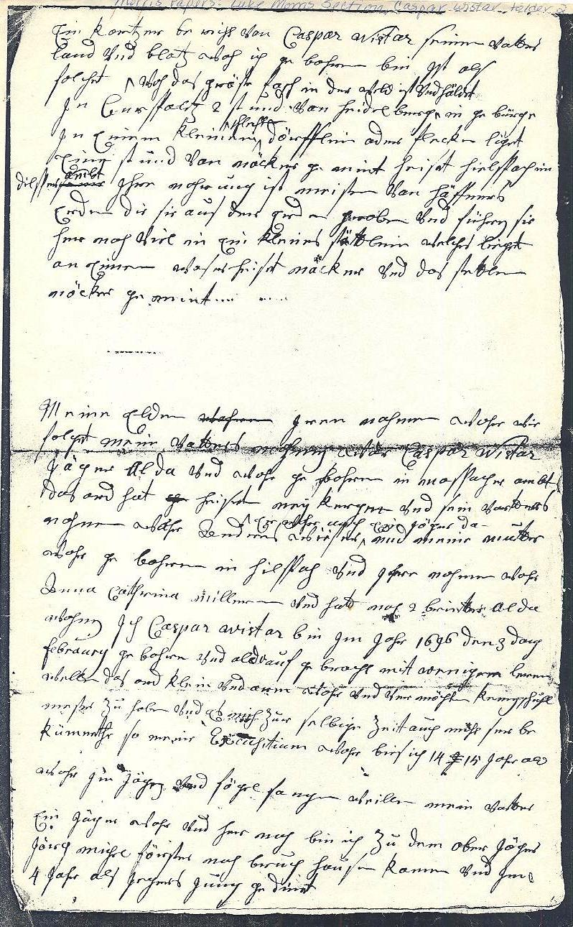
Sample Autobiography Draft in German

Slide 9
Detail from Wistar Autobiography

Slide 10
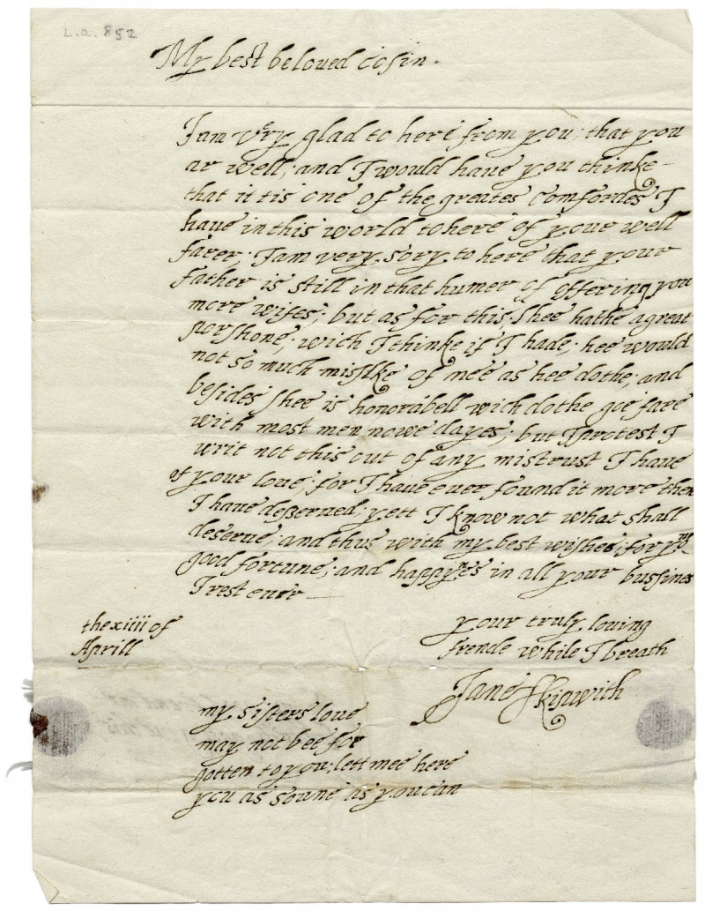
Jane Skipwith's ca. 1610 love letter to her cousin. Folger Digital Image 5762.

Slide 11
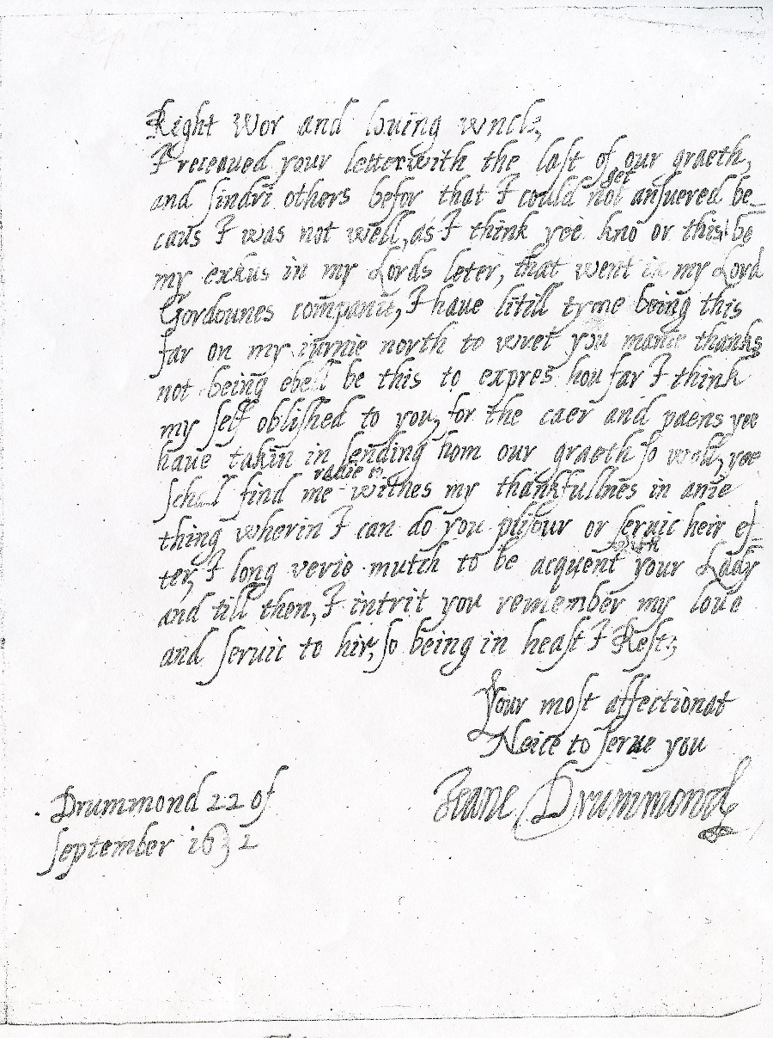
Jean Drummond, Countess of Southerland to Sir Robert Gordon, 22 September, 1632
Jean Drummond, Countess of Sutherland, to Sir Robert Gordon of Gordonstoun, Drummond, 22 September 1632.
National Library of Scotland Dep 175/65/Bundle 2. CSC DrummondJ63201 # 676. Published by the kind permission of
the Trustees of the Cumming of Altyre Papers (National Library of Scotland, Dep. 175).

